Slide 1
Intro to Practical development
Making things with raspberry Pi and Python!

Slide 2
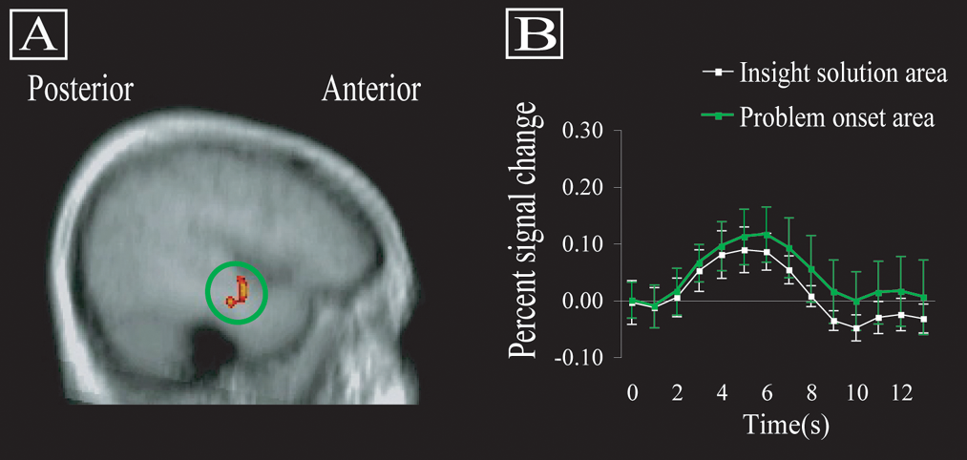
Practical Development

Slide 3
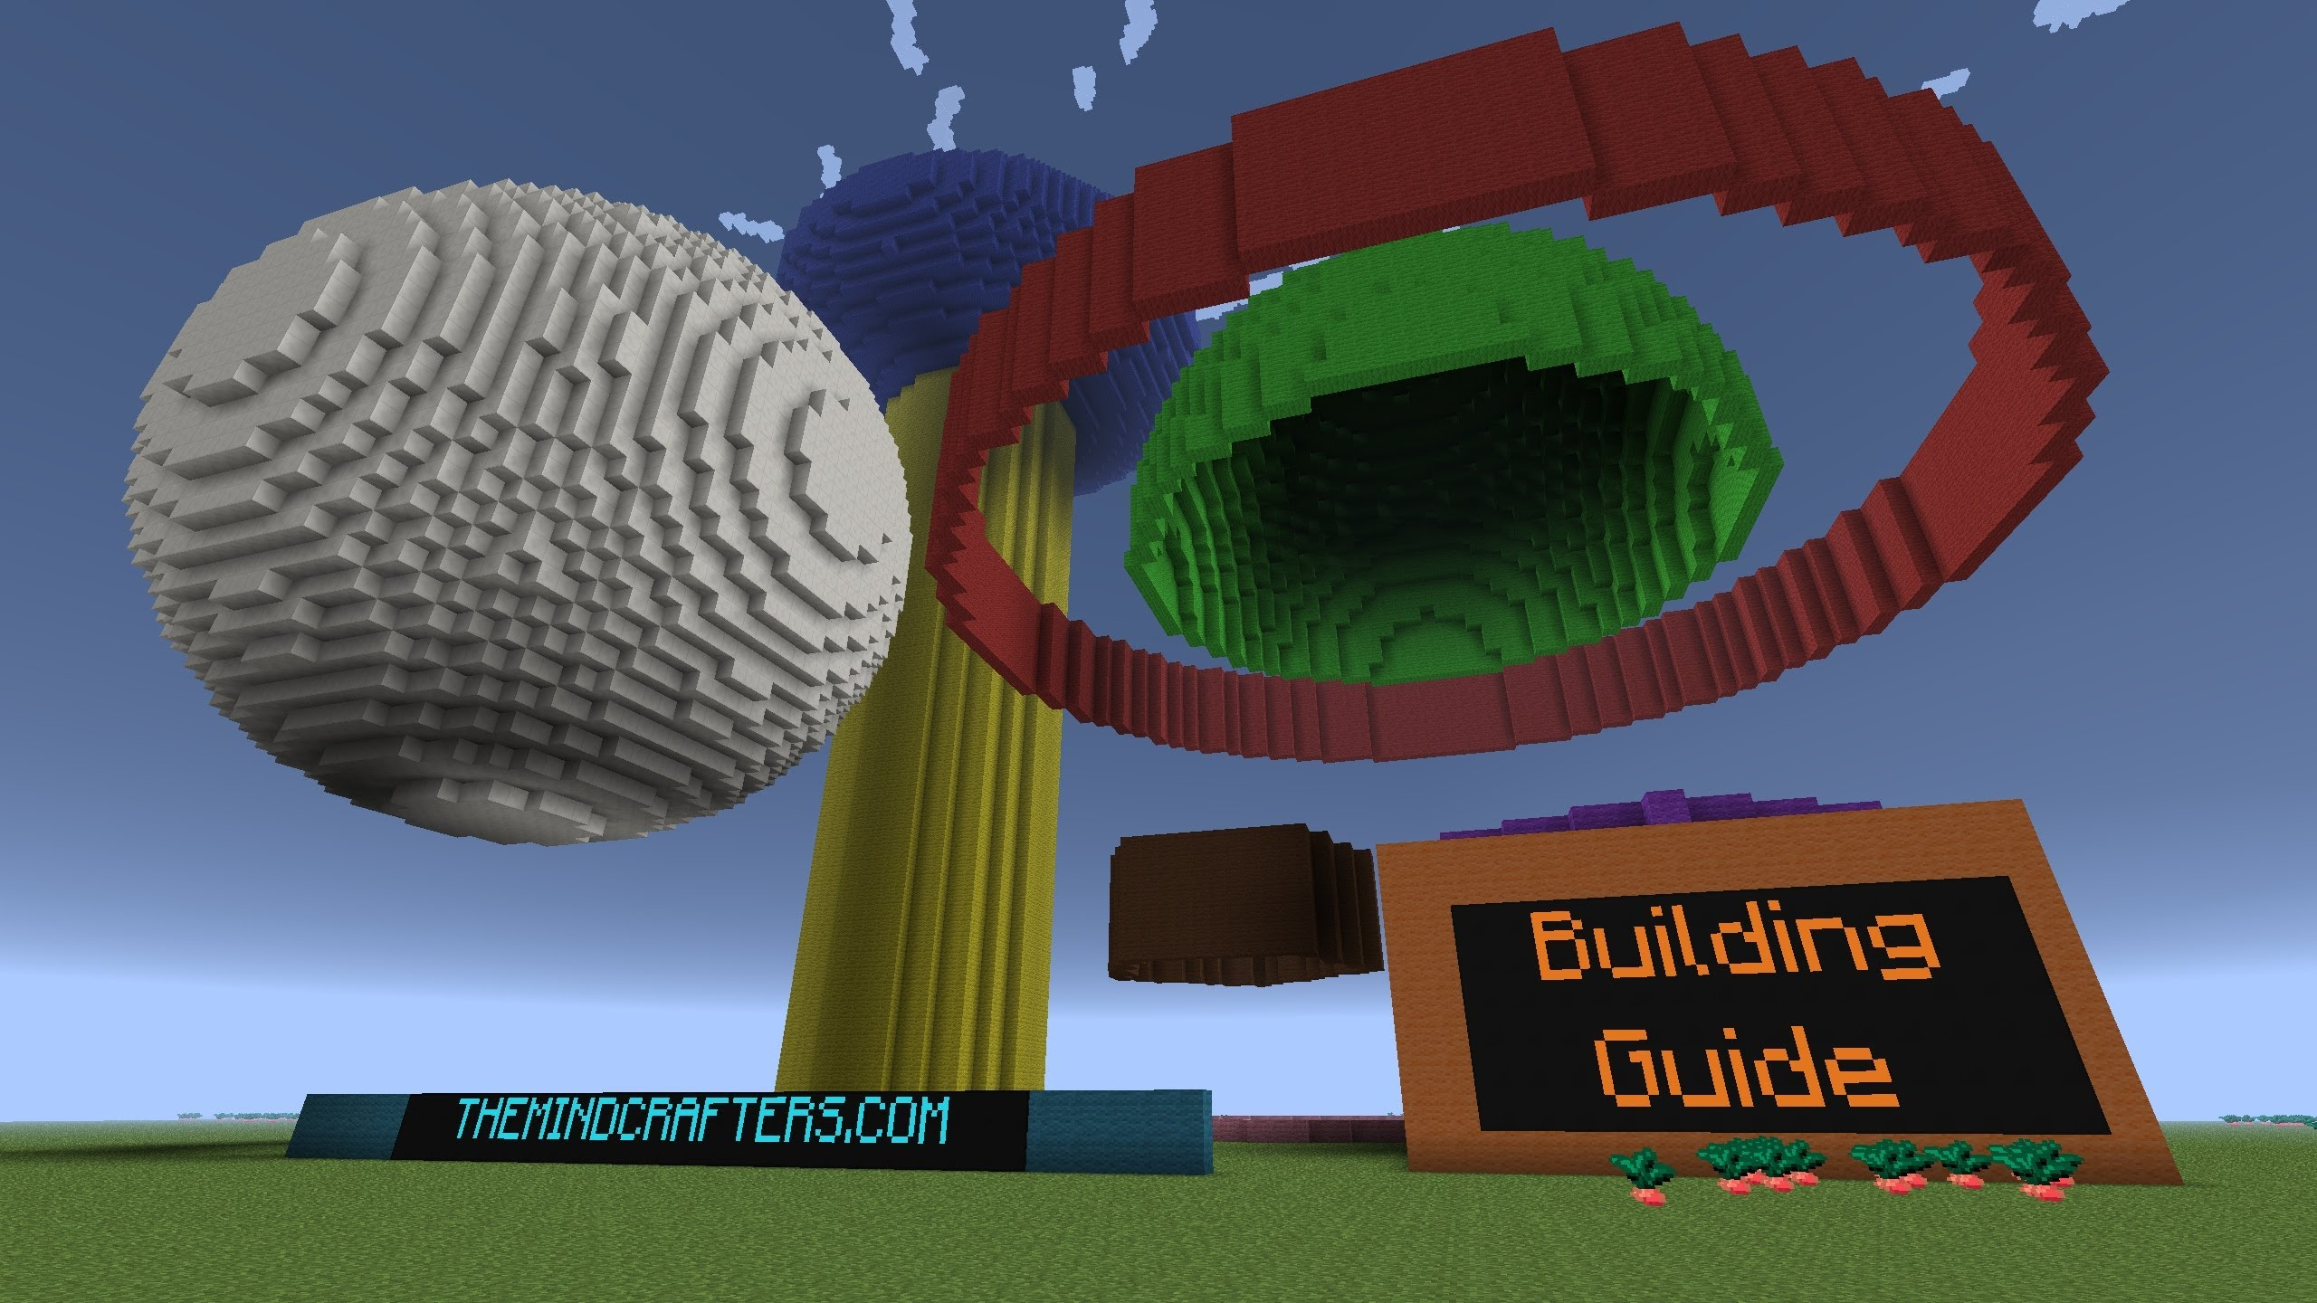
What are we doing?

Slide 4
Hardware

Slide 5
wiring

Slide 6


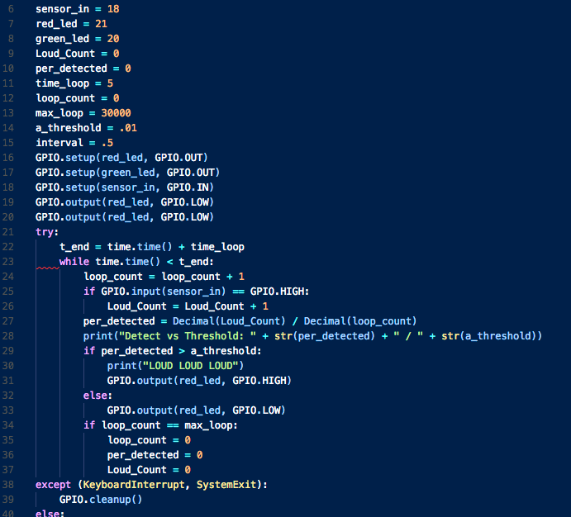
software
Variables
Functions
Inputs
Outputs

Slide 7
What’s next

